Slide 1




Oost NL
matchmaking event
Solartechno Europe B.V.
www.solartechno.com
info@solartechno.com
01-02-2023, online presentatie

Slide 2

Our dream
Our dream is…
      making solar energy available for everyone, everywhere, even in remote areas without a grid-connection. No more polluting diesel generators!

Slide 3
Managing Team
Marco Ghirardello: Dutch / Italian Aerospace Engineer (Graduated here at Politecnico!), full time MBA SDA Bocconi. Since 2002 in the solar industry starting as business developer manager at Shell Solar (Amsterdam), later CEO of ENERRAY S.p.A., then manager at Evelop B.V. (Econcern B.V. Utrecht). Marco owns 96% of Solartechno Europe B.V.
Edgard Creemers: Dutch, Master in Bio-organic chemistry. Financial and strategy advisor and investor. Helps Solartechno as financial advisor. Minority shareholder in Solartechno
Diederik Wawoe: Dutch, Business developer for the African markets
Former Shell Solar and manager at Shell Global Solutions for Africa. Owner of Wawoe Ventures, his company is financing Solar projects in Sub-Saharan Africa and geothermal R&D projects in Europe
Cent Van Vliet: Dutch, business developer for market segments Defence, NGO, agri-food.

Slide 4




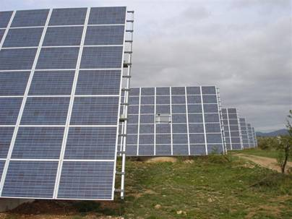
Main activities
Distribution | Turnkey installation | Consulting | Product Development
Trading of PV modules Distribution of PV components to small and medium size installers Sales of our modular Lithium-ion battery “OffGridBat” | Turnkey installation of medium size and large PV systems: - On grid - Off grid | Technical, market & economical consulting in the Solar industry Business plans and evaluation of investment in the Solar industry Repetitive customers like McKinsey, Goldman Sachs BCG and large investors (Clearwater, Silver Lake) | Research & Development: Off-grid solar generator Innovations in battery technology usage OffGridBat: a modular plug and play solar generator specifically designed for the African and Middle East markets
www.solartechno.com

Slide 5
What are our growth needs
Short and medium term neds:
Engineering support to design a standard medium voltage (400-800 Volt) energy storage system:
  Continuous update about norms and laws
  Choose of suitable main components like inverter/chargers
  Design of the DC circuit and selection of safety components
On site installation support for turnkey projects in NL
Marketing: implementation of marketing strategy online
  New website
  Outsourcing of PR and online marketing activities (LinkedIn, Twitter)
Company Growth strategy and its implementation
  Partner for outsourcing distribution warehouse
www.solartechno.com

Slide 6
Back up slides
Back up slides
www.solartechno.com

Slide 7
Global network
www.solartechno.com

Slide 8
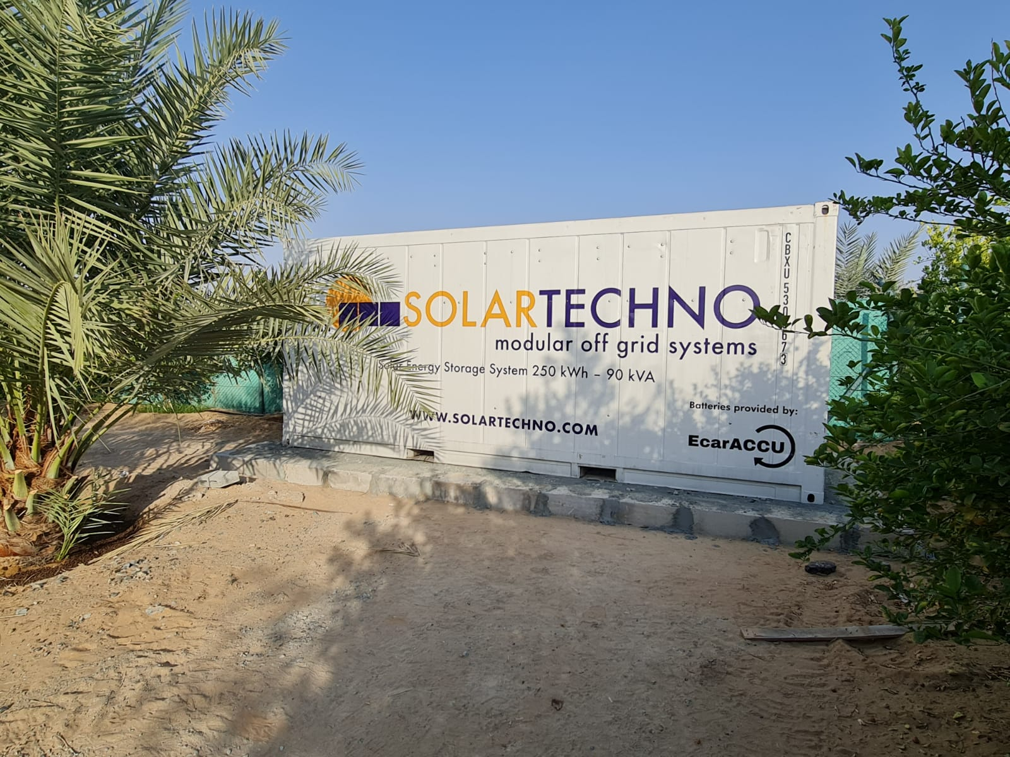
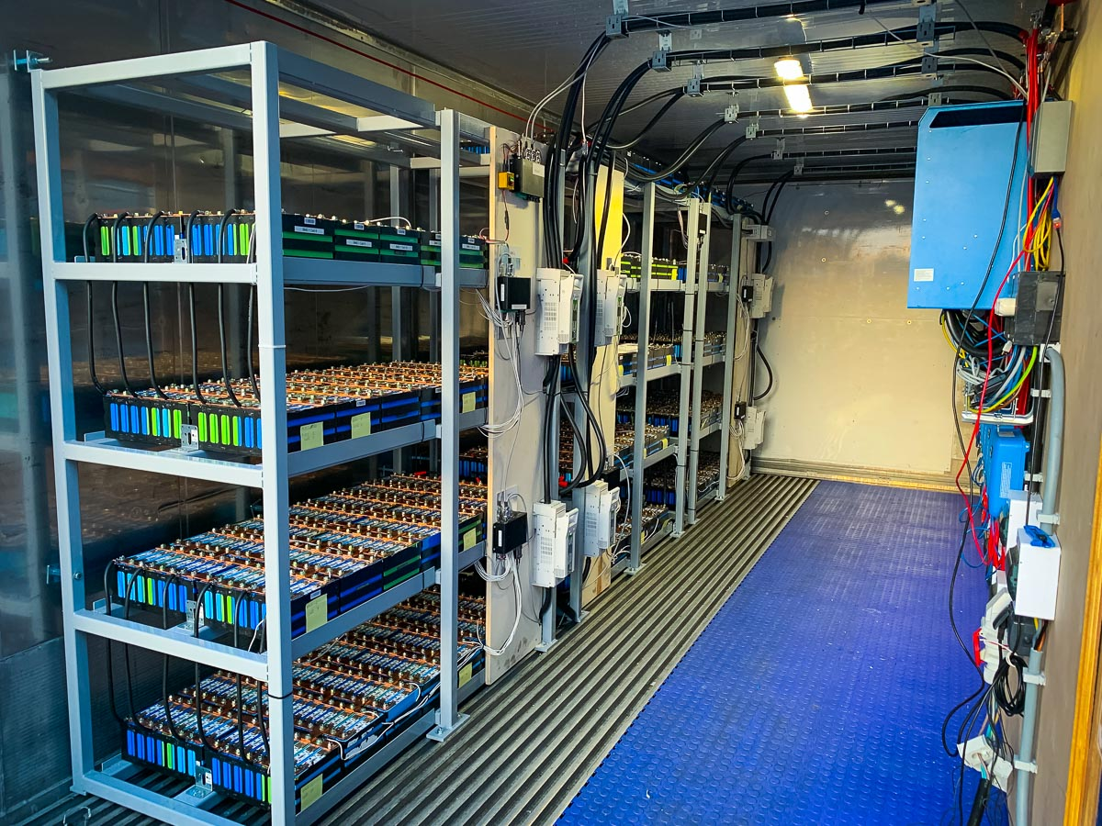


Large battery with recycled cells
250 kWh – 90 kVA in the Emirates, powering a large remote villa. Build in 2020
1568 battery cells recovered from 20 Mitsubishi Outlander cars (cars made in 2012 to 2017)
Notes:
OffGridBat has been already installed in several locations in the world.
Show the audiences that OffGridBat is capable of working even there is no distribution grid on site.

Slide 9
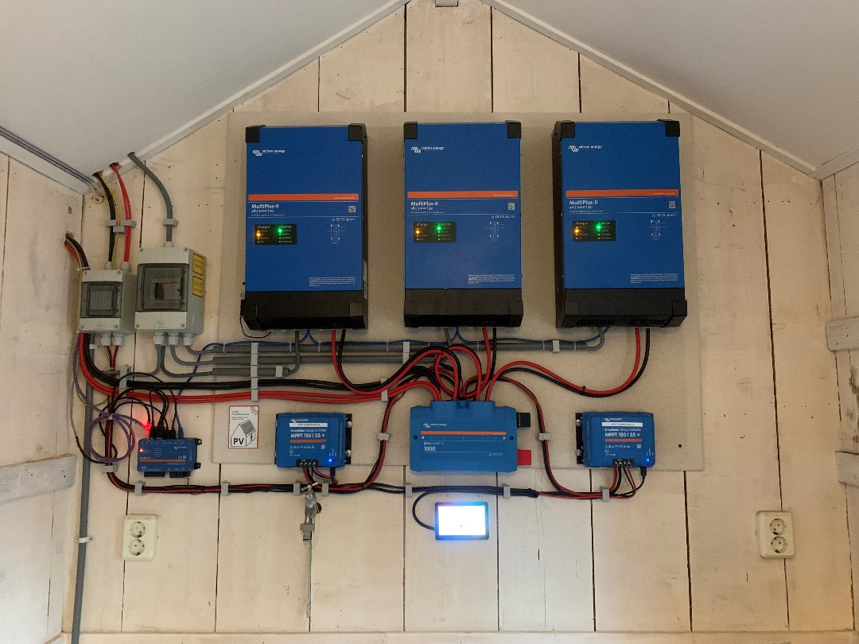
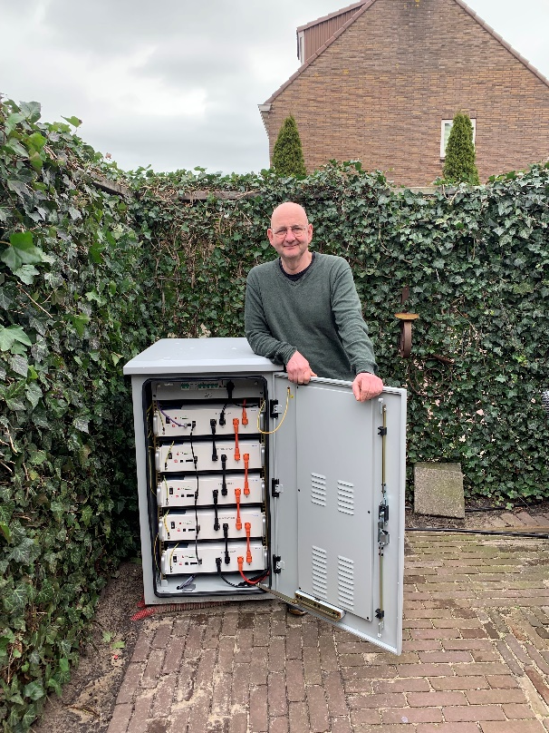
Medium size batteries
30 kWh – 9 kVA in North Holland, powering a house. Build in 2022.
Now the customer is energy independent from March to September
Inverters for the same energy storage system
Notes:
OffGridBat has been already installed in several locations in the world.
Show the audiences that OffGridBat is capable of working even there is no distribution grid on site.

Slide 10
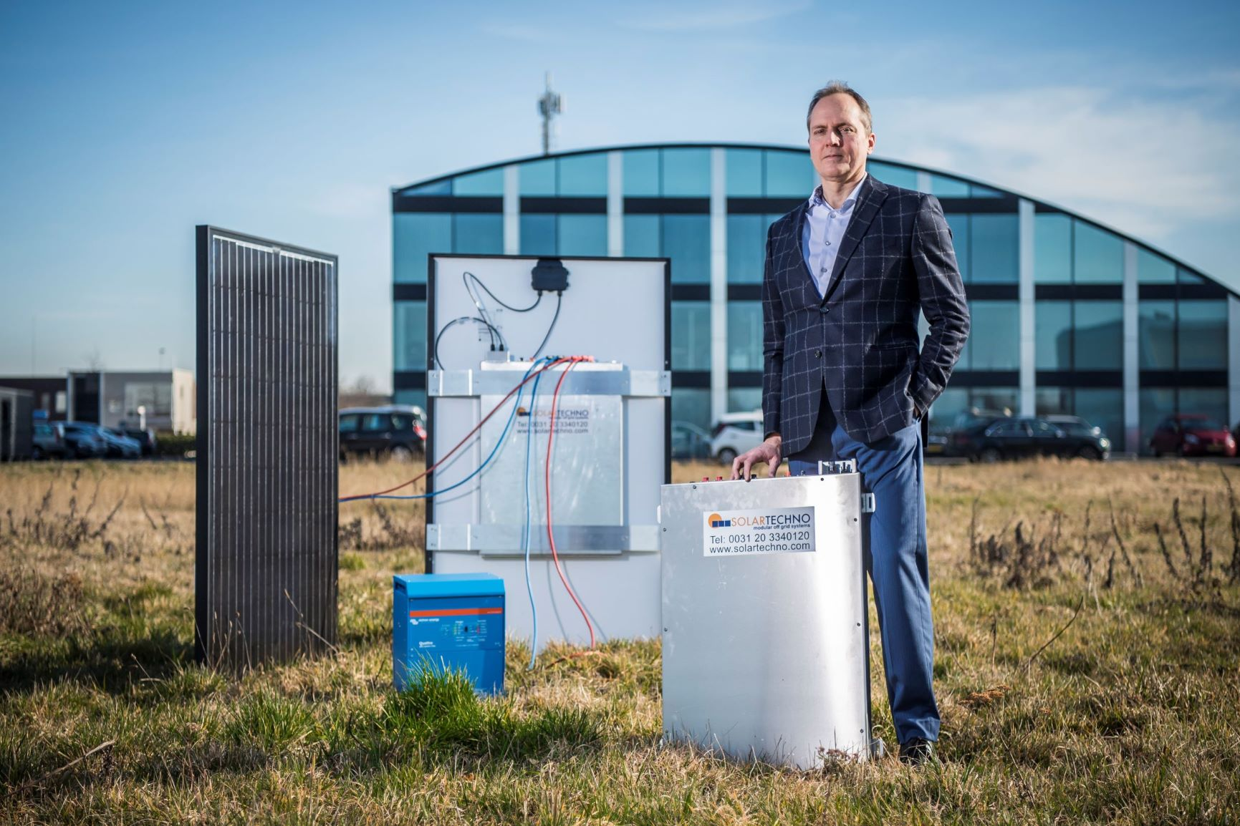
A fully working system
Two OffGridBat and their solar panels connected to an inverter for a total of 2.4 kWh storage, 2 kW power.
This is sufficient for powering a shop in Africa.

Slide 11
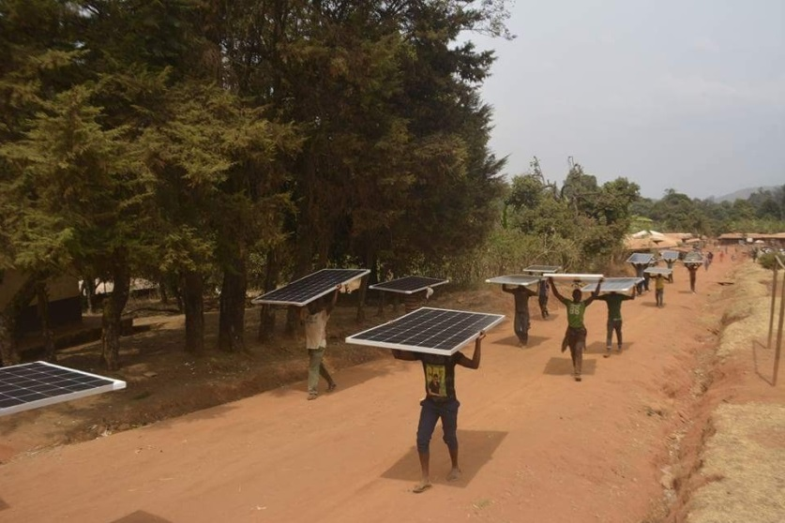
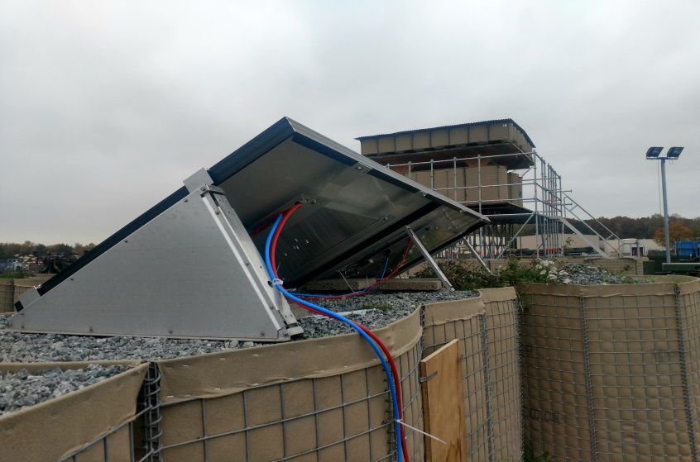
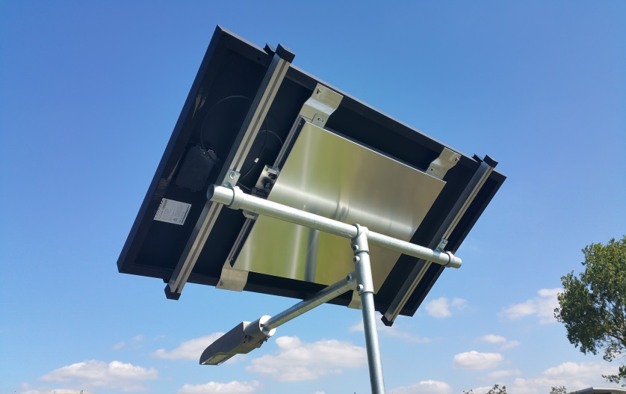
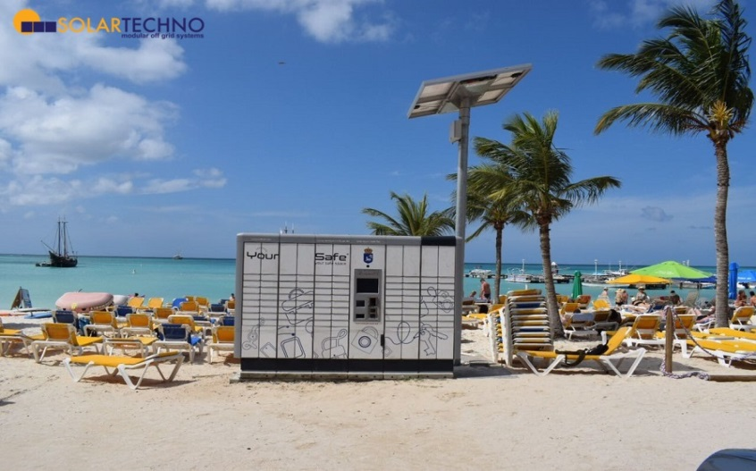
“OffGridBat” Installation
Powering school in Cameroon
Installation on a remote camp
Street lighting solution
Aruba Island, The Caribbean
Notes:
OffGridBat has been already installed in several locations in the world.
Show the audiences that OffGridBat is capable of working even there is no distribution grid on site.

Slide 12
Project Management
Process:
Assessment of customer needs
Concept and feasibility study
System design & detailed engineering
Procurement
Construction throught local installators
Commissioning
Remote monitoring and support
www.solartechno.com

Slide 13

Consulting
With years of expertise in solar industry and a team of energy engineers Solartechno is the partner to ask for a helping hand when energizing your business is a challenge.
Solartechno assists solar business, industry organizations and government departments to assess solar power across a wide number of specialist area:
Techno-economic optimization,
ROI calculation, comparing quotes or offers from various suppliers
Forecasts
Industry snapshots
System performance analysis
Government consulting
Solar project evaluation
www.solartechno.com

Slide 14
Conclusion
Thank you for your interest
Hestiastraat, 75 III
1076 DK, Amsterdam - NL
Landline: +31 203340120
www.solartechno.com
Marco Ghirardello
marco@solartechno.com
Mobile phone line: +31 653215667

